Slide 1

Results of the Latvian
State scholarships for foreigners for the academic year
2025./2026.

Slide 2
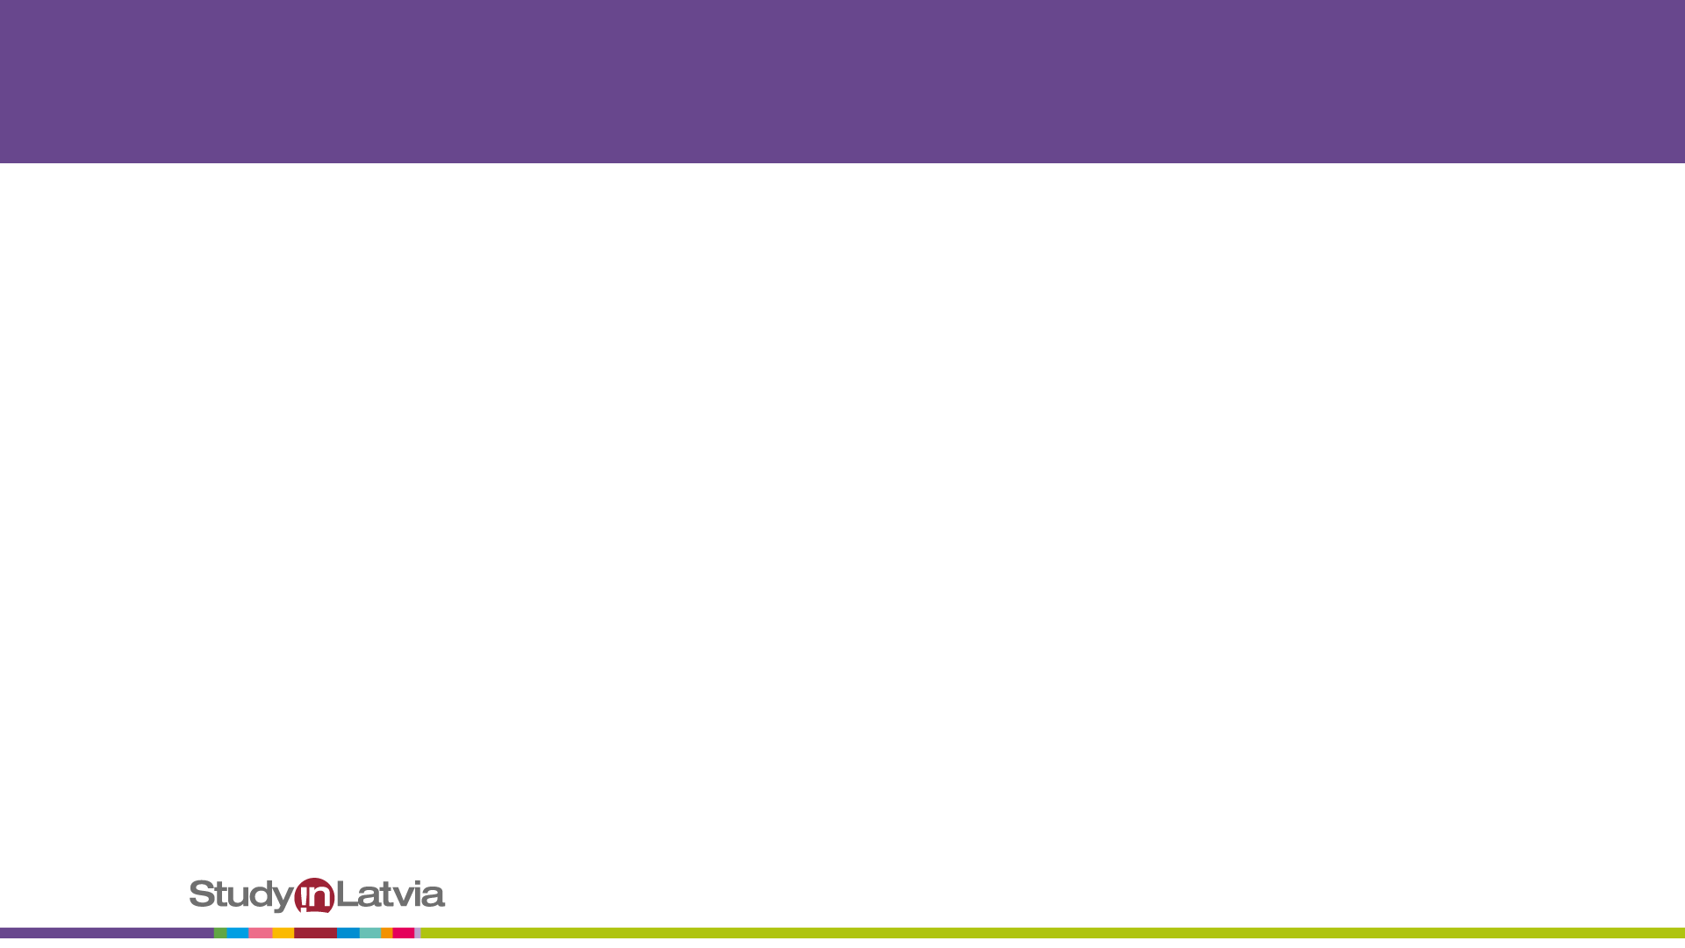
Latvia state funding for scholarships, EUR

Slide 3
An overview of the Latvian state study scholarships

Slide 4
Distribution of scholarships by higher education institutions
 | BAT | LBTU | SSE | DU | TSI | BA | ViA | EKA | BSA | JVLMA | LMA | RISEBA
2023./2024. | 7 | 6 | 6 | 3 | 3 | 1 |  | 1
2024./2025. | 4 | 5 | 6 | 6 | 4 | 1 |  | 2 | 1 | 1 |  | 1
2025./2026 | 5 | 7 | 5 | 3 | 4 | 1 | 1 | 1 | 1 | 3 | 1 | 2

Slide 5
Distribution of Latvian state study
scholarships by study levels

