Slide 1

Results of the Latvian
State scholarships for foreigners for the academic year
2024./2025.

Slide 2
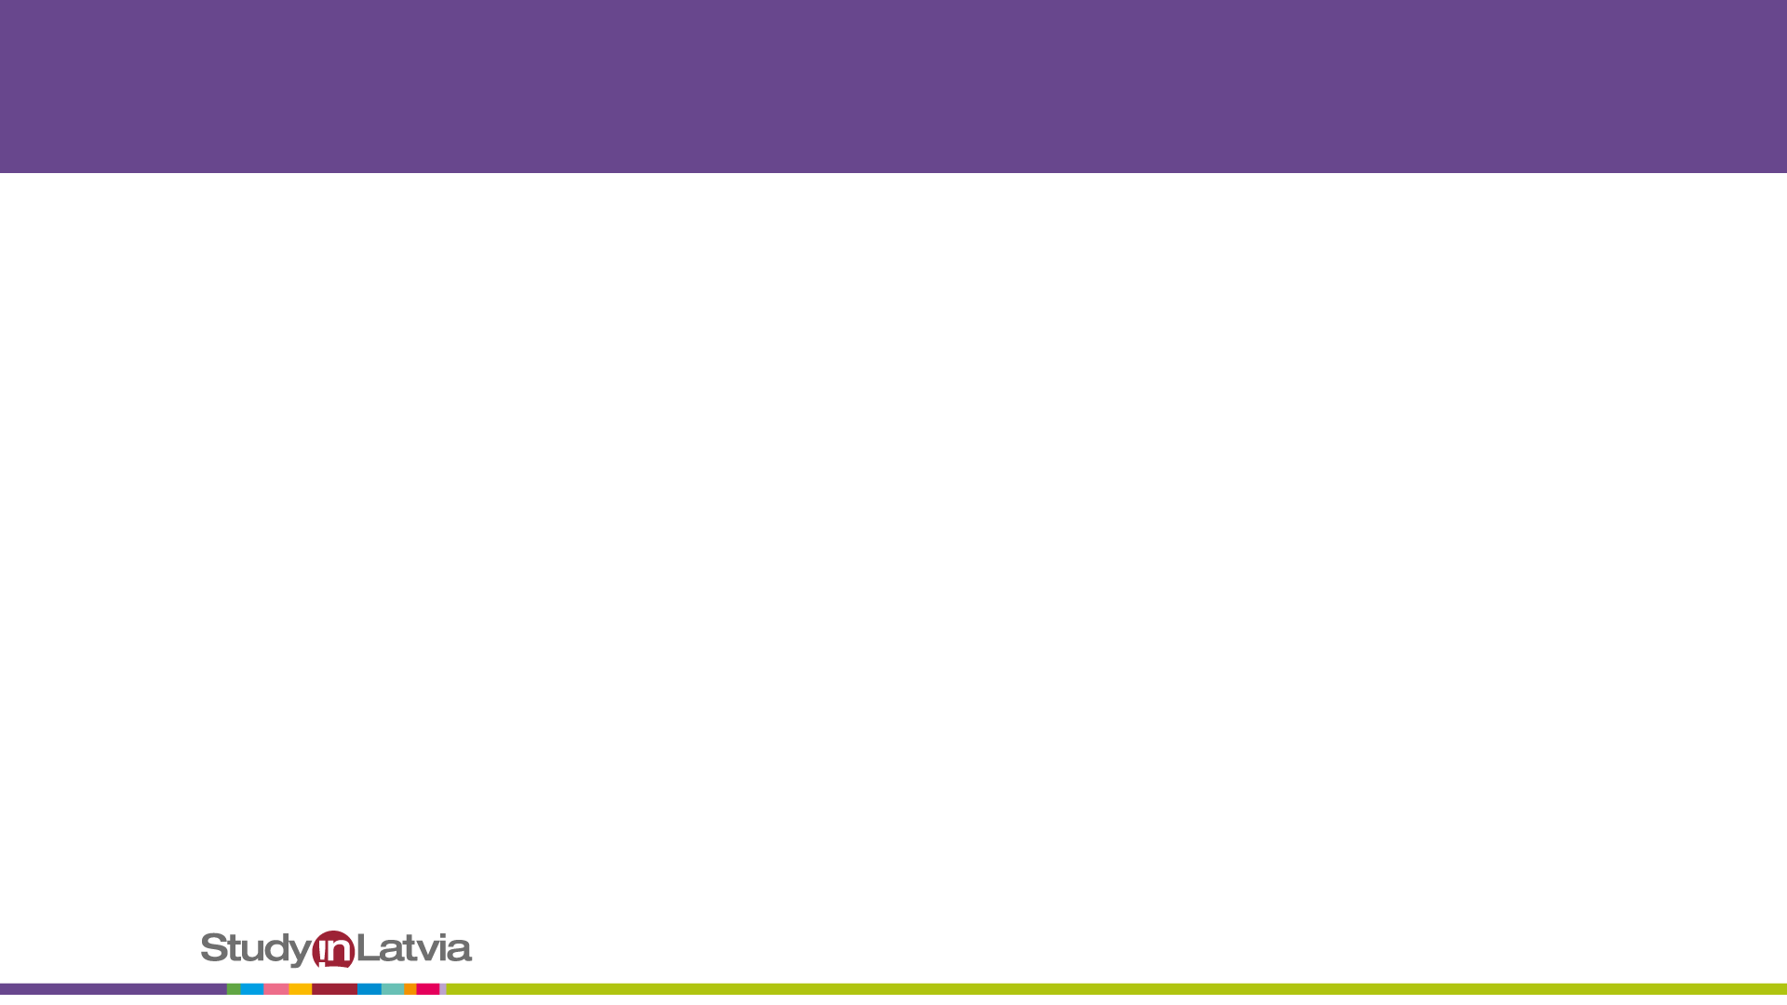
Latvia state funding for scholarships, EUR

Slide 3
An overview of the Latvian state study scholarships

Slide 4
Distribution of scholarships by higher education institutions
 | Turība | LBTU | SSE | DU | TSI
2021./2022. | 3 | 2 | 2 | 1
2022./2023. | 8 | 6 | 1 | 2 | 1
2023./2024. | 7 | 6 | 6 | 3 | 3
2024./2025. | 4 | 5 | 6 | 6 | 4

Slide 5
Distribution of Latvian state study
scholarships by study levels

Slide 6
Distribution of Latvian state study scholarships by sectors

