Slide 1
Results of the Latvian State scholarship application round for the academic year 2023./2024.

Slide 2


Slide 3
Results of the Call for applications for the Latvian state scholarships - success rate

Slide 4


Slide 5
Latvia state funding for scholarships, EUR

Slide 6


Slide 7
An overview of the Latvian state study scholarships

Slide 8
Overview of the countries with the largest number of scholarship applications
"TOP" 9 countries and success rate
* The indicator is affected by the quota for particular countries

Slide 9


Slide 10
Distribution of scholarships by higher education institutions
Other higher education institutions
 | Turība | LBTU | REA (SSE) | DU | TSI | LSPA | LiepU | BA | EKA | RJA
2023/ | 7 | 6 | 6 | 3 | 3 | 2 | 2 | 1 | 1 | 1
2024
2022/ | 8 | 6 | 1 | 2 | 1 | 2 |  | 3 | 1 | 2
2023
2021/ | 3 | 2 | 2 | 1 |  |  |  | 2 |  | 2
2022

Slide 11
Higher education institutions success rate

Slide 12


Slide 13
Distribution of Latvian state study scholarships by study levels

Slide 14
Distribution of Latvian state study scholarships by sectors

Slide 15


Slide 16
Latvian state scholarships for summer schools in 2022
9 summer schools were approved out of 22 applications ( 10 scholarships for each summer school )

Slide 17
Latvian state scholarships for summer schools and reservists by countries

Slide 18
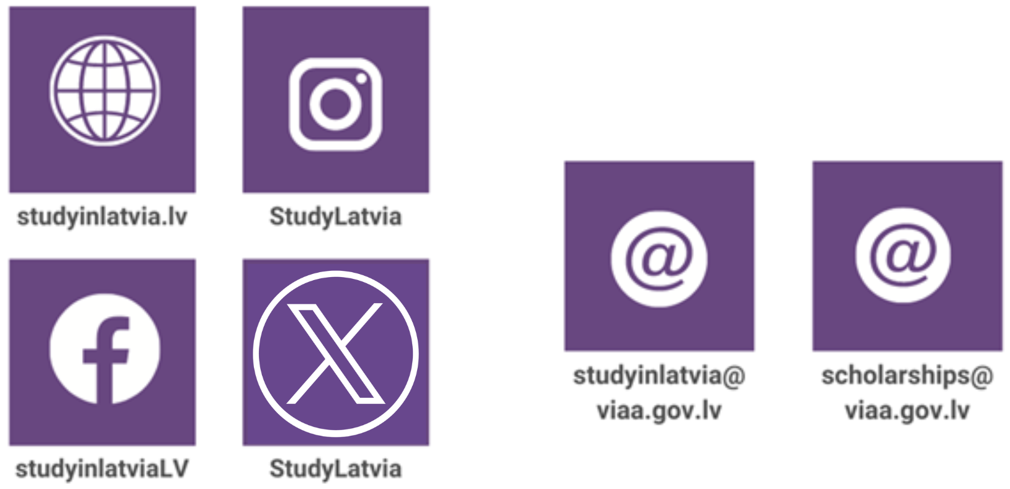

Information on the Latvian state scholarships

