Slide 1

Results of the Latvian State scholarship application round
for the academic year 2022./2023.

Slide 2


Slide 3
Results of the Call for applications for the Latvian state scholarships - success rate
Academic year 2022./2023.
Studies - 34%
111
332
Summer schools - 47% (70 scholarships)
⁷ 15
Research - not launched
0
50 100 150 200
Academic year 2021./2022.
250
300
350
Studies - 33%
102
307
Research - 26%
22
84
Summer schools - 53% (80 scholarships)
⁸15
0
50 100 150 200
Academic year 2020./2021.
250
300
350
Studies - 36%
95
261
Research - 28%
24
87
Summer schools - 57% (80 scholarships)
⁸14
0
50 100
Applications selected
150
200 250 300
Applications submitted

Slide 4


Slide 5
Latvia state funding for scholarships, EUR
Academic years 2020./2021. , 2021./2022. un 2022./2023.
450 269 |  |  |  |  |  |  |  | 49 770
450 269 |  |  |  |  | 84 444 |  | 56 880
449 129 |  |  |  |  | 85 584 |  | 56 880
2022./2023.
591 593 EUR
2021./2022.
591 593 EUR
2020./2021.
591 593 EUR
0
100 000
200 000
300 000
400 000
500 000
600 000
Studies
Research
Summer schools

Slide 6


Slide 7
An overview of the Latvian state study scholarships
Distribution of scholarships awarded by country (applications received from
35 countries, scholarships awarded to 26 countries)
Ukraine
16
Finland
11
Sweden, Germany, Azerbaijan
10
People's Republic of China
9
Kazakhstan
7
Uzbekistana, Israel
5
Norway, Lithuania
3
Vietnam, Türkiye, Italy, Mexico, Kyrgyzstan,
Indonesia, Georgia
USA, Tajikistan, Sweden, Peru, Japan, Hungary, France, Austria
2
1

Slide 8
Overview of the countries with the largest number of scholarship applications
"TOP" 11 countries and success rate
Ukraine - 42%
16
38
Finland - 29% *
11
38
Germany - 37% *
10
27
Azerbaijan - 17% *
10
60
Sweden - 59%
10
17
People's Republic of China…
⁹10
Kazakhstan - 58%
7
12
Israel - 45%
5
11
Uzbekistan -24%
21
Norway - 100%
3
3
Lithuania - 75%
3₄
0
10
20
30
40
50
60
* The indicator is affected by the quota for particular countries
Number of applications selected
Number of applications submitted

Slide 9


Slide 10
Distribution of scholarships by higher education institutions
"TOP" 3 higher education institutions
RSU
34
41
44
LU
18
23
21
RTU
18
25
24
0
5
10
15
2022./2023.
20
25
2021./2022.
30 35
2020./2021.
40
45
Other higher education institutions
 | Turība | LLU | BA | ViA | JVLMA | RJA | DU | RISEBA | LSPA | LMA | BSA | EKA | REA (SSE)
2022/ 2023 | 8 | 6 | 3 | 3 | 2 | 2 | 2 | 2 | 2 | 2 | 2 | 1 | 1
2021/ 2022 | 3 | 2 | 2 | 1 | 2 | 2 | 1 | 1 |  |  |  |  | 2
2020/ 2021 | 3 |  | 4 | 1 | 1 | 2 | 2 |  |  |  |  |  | 1

Slide 11
Higher education institutions success rate
"TOP" 3 higher education institutions
RSU - 43%
34
79
RTU - 23%
18
77
LU -45%
23
51
0
10
20
30
40
50
60
70
80
Number of invitation letters issued
Number of study scholarships awarded

Slide 12


Slide 13
Distribution of Latvian state study scholarships by study levels
14
42
37
18
Doctoral level studies
Master level studies
Bachelor level studies
2nd level professional higher education

Slide 14
Distribution of Latvian state study scholarships by sectors
Information and communication… Teacher training and education…
Veterinary
Engineering and technologies
Arts
Social and behavioral sciences
Law Computer science
Other fields Humanities
Business and administration
Health care
1
2
4
5
5
6
6
7
8
13
14
40
0
5
10
15
20
25
30
35
40

Slide 15


Slide 16
Latvian state scholarships for summer schools in 2022
7 summer schools were approved out of 15 applications ( 10 scholarships for each summer school )
RTU - Deep Learning for Cybersecurity 110
RTU - Fracture structures: Material Stress Resistance 84
RTU - Waste Management. Clearwater Technologies 57
DU - Soviet Military History Traces in the Territory of Latvia
DU - Phenonemology of the Border Area: Eastern
Latvia
RTU - Urban Gardening. Sustainable, Green Impact on Modern Cities
LU - Summer School of Latvian language and culture 2022
48
43
39
25
0
20 40
Applications submitted
60
80
100
120

Slide 17
Latvian state scholarships for summer schools and reservists by countries
Uzbekistan
25
People's Republic of China, Mexico, Germany
11
Türkiye
10
Ukraine
8
Italy
7
Kazakhstan
6
Azerbaijan, Greece, Indonesia
5
Poland, Spain
4
Czech Republic, France, Georgia, Slaovakia
3
USA, Lithuania, Moldova, Tajikistan
2
Bulgaria, South Korea, Croatia, Estonia, Japan
1
Kyrgyztan, Peru, Hungary
0 5
Applications submitted
10
15
20
25

Slide 18
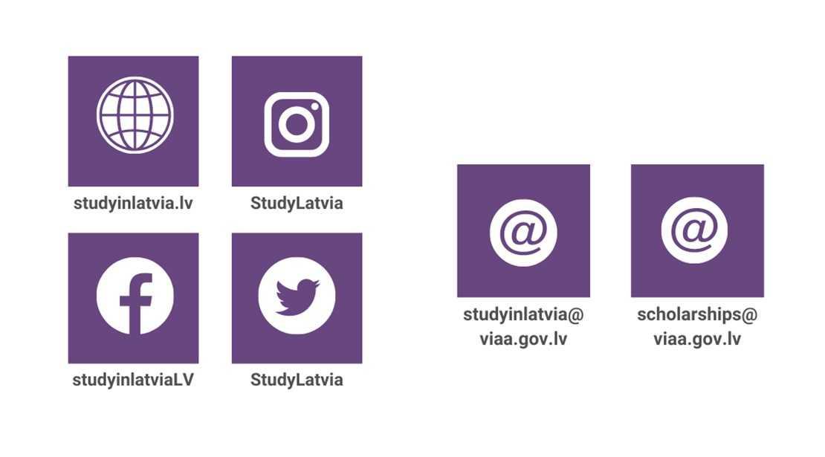

Information on the Latvian state scholarships

