Slide 1
Results of the Latvian State scholarship application round for the academic year 2021./2022.

Slide 3
Results of the Call for applications for the Latvian state scholarships - success rate

Slide 5
Latvia state funding for scholarships, EUR

Slide 7
An overview of the Latvian state research and study scholarships awarded

Slide 8
An overview of the Latvian state research and study scholarships awarded

Slide 9
Overview of the countries with the largest number of Latvian state research and study scholarship applications
"TOP" 12 countries and success rate
* The indicator is affected by the quota for particular countries

Slide 11
Distribution of scholarships granted for studies and research by higher education institutions

Slide 12
Distribution of scholarships granted for studies and research by higher education institutions
Other universities
 | BA | Turī ba | LLU | REA (SSE) | JVLMA | RJA | DU | LKA | ViA | RISEBA | VA | RTA | ISMA
2021/ 2022 | 3 | 3 | 3 | 3 | 2 | 2 | 1 | 1 | 1 | 1 | 1 | 1 | 1
2020/ 2021 | 4 | 3 | 2 | 2 | 1 | 2 | 2 | 2 | 2
2019/ 2020 | 3 | 1 | 3 | 3 | 2 | 2 | 2 | 1 | 1 | 1 | 2
BA- BA School of Business and Finance
Turība - Turība University
LLU - Latvia University of Life Sciences and Technologies
REA (SSE) - Stockholm School of Economics in Riga
JVLMA - Jāzeps Vītols Latvian Academy of Music
RJA - Riga Graduate School of Law
DU - Daugavpils University
LKA - Latvian Academy of Culture
ViA - Vidzeme University of Applied Sciences
RISEBA - "RISEBA" University of Business, Arts and Technology
VA - Ventspils University of Applied Sciences
RTA - Rezekne Academy of Technologies
ISMA - ISMA University of Applied Sciences

Slide 13
Universities success rate – scholarships for studies and for research

Slide 15
Distribution of Latvian state study scholarships by study levels

Slide 16
Distribution of Latvian state research scholarships by sectors

Slide 17
Distribution of Latvian state research scholarships by sectors

Slide 19
Latvian state scholarships for summer schools in 2021 - 8 summer schools were approved out of 15 applications, 10 scholarships for each summer school were awarded

Slide 20
Latvian state scholarships for summer schools in 2021 - distribution of awarded scholarships and reservists by countries

Slide 21
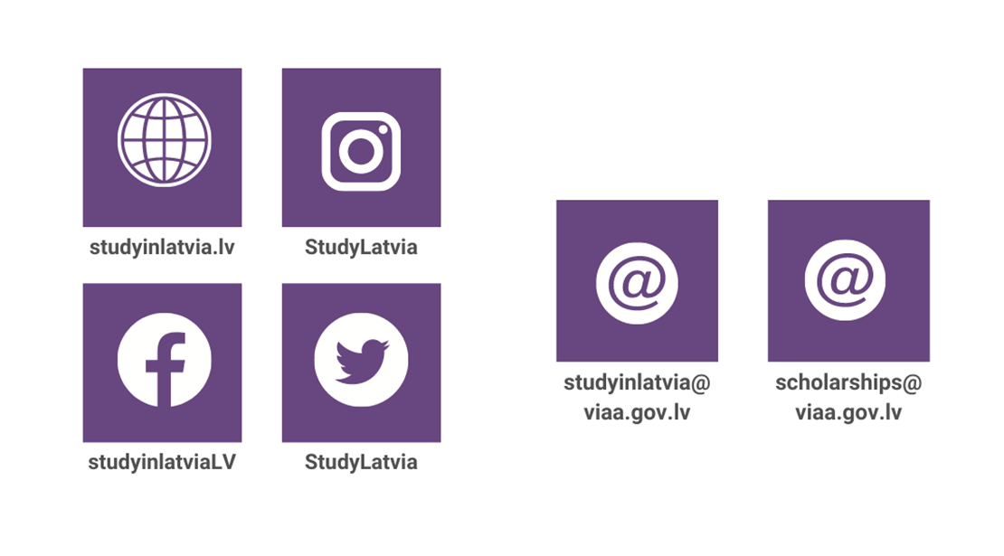
Information on the Latvian state scholarships

